Slide 1
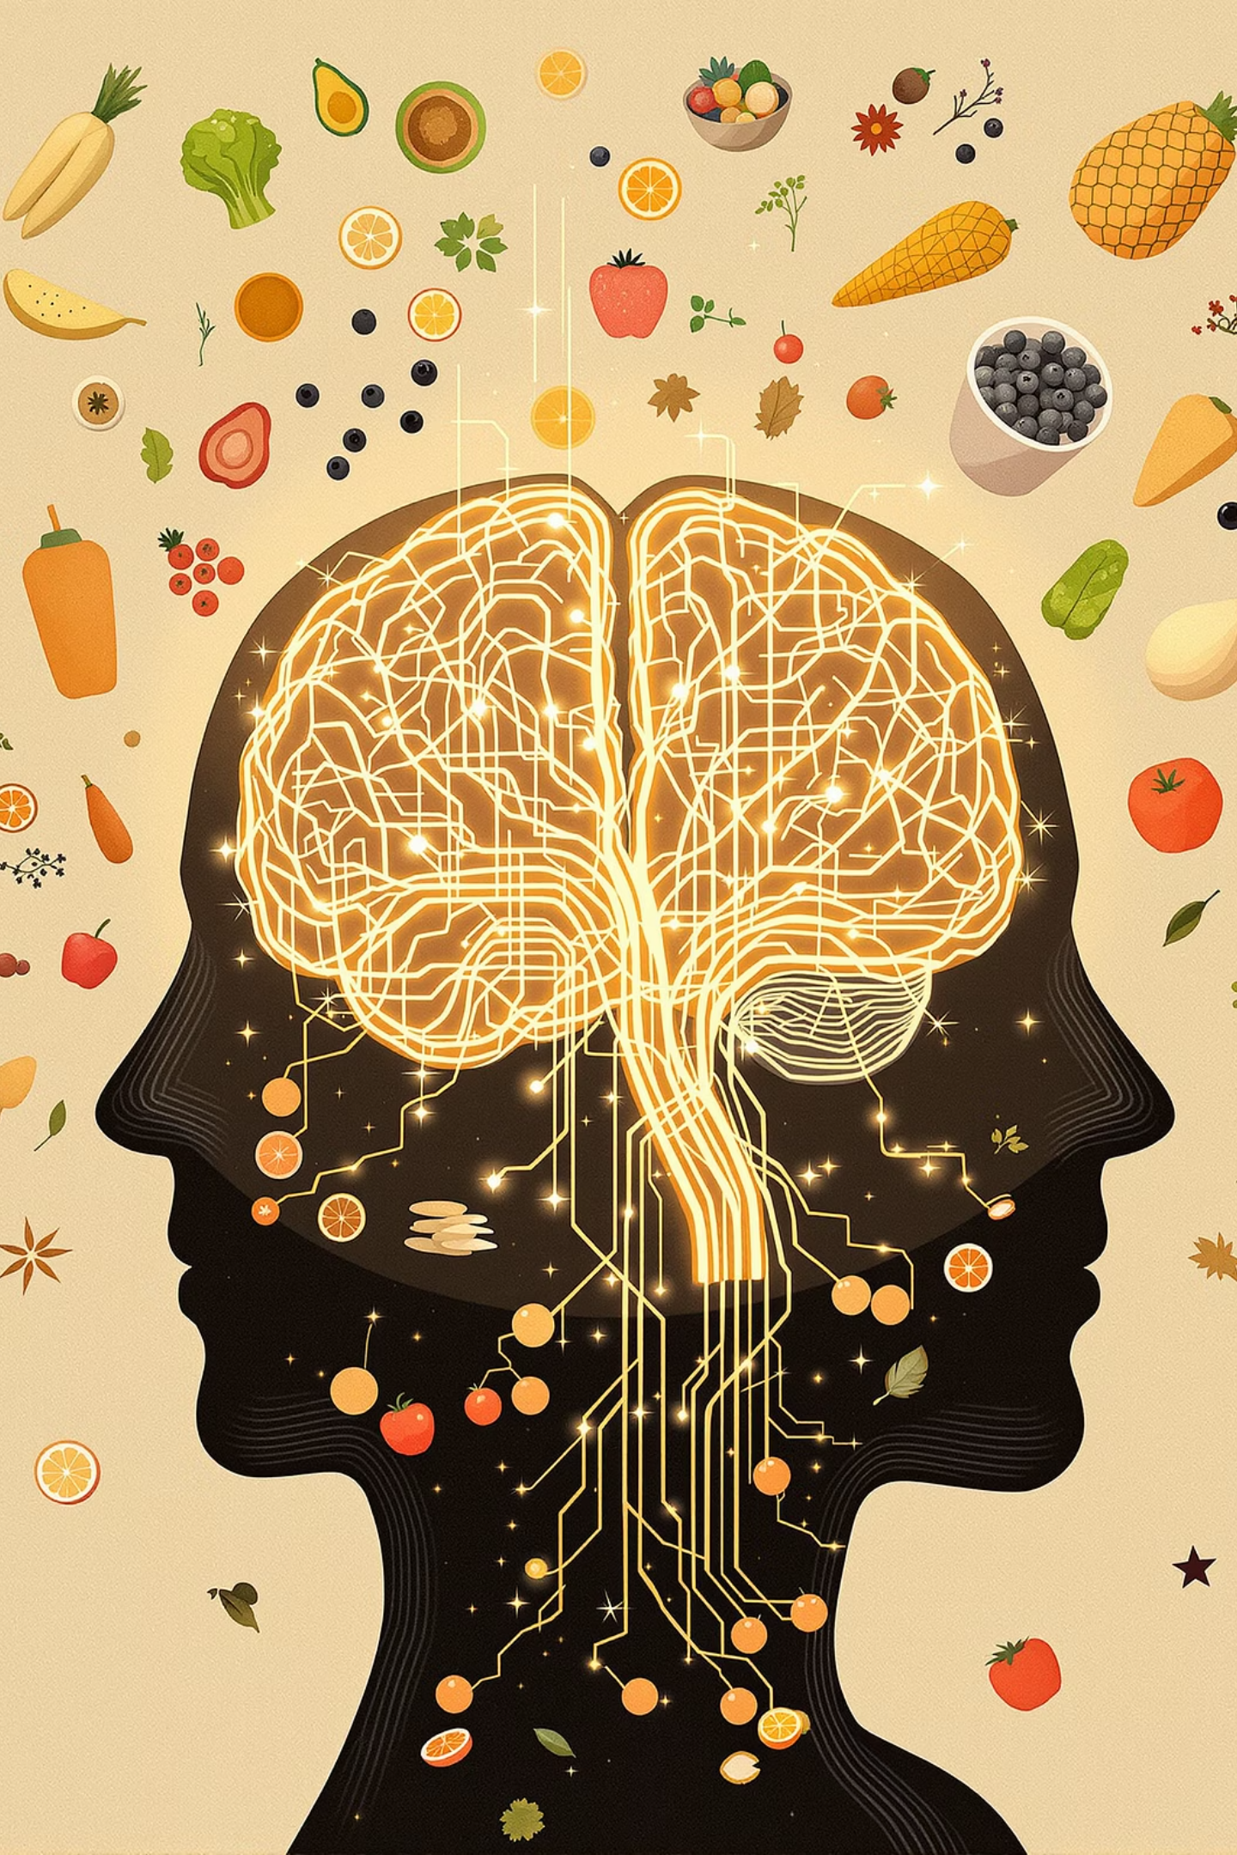
Metabolic Psychiatry
A new approach to mental health

Slide 2

Disclosure Statement
Important Notice
Consult Professionals
Educational Purpose
This presentation is for informational purposes only. It does not constitute medical or psychiatric advice.
Always consult a qualified healthcare professional for specific guidance.
Content is designed to educate the general public about metabolic psychiatry concepts.
Notes:
This presentation is for educational purposes only and does not provide medical or psychiatric advice. The information shared is intended to support awareness and understanding of metabolic psychiatry, not to replace individualized care. Please consult a qualified healthcare professional for guidance specific to your situation.

Slide 3

My Metabolic Psychiatry Journey
Notes:
This is an optional slide if the user wants to share a compelling story.

Slide 4




What is Metabolic Psychiatry?
New Approach
Looks beyond symptoms to explore how energy systems affect the brain
Energy Focus
Studies how the body's energy production impacts mood and cognition
Lifestyle Integration
Uses nutrition and lifestyle changes to support brain function
Notes:
Metabolic psychiatry is an emerging field that looks at mental health through the lens of metabolism—how the body and brain make and use energy.
Interventions that improve metabolic health, like nutrition changes, exercise, sleep optimization, and stress reduction—are showing promise in reducing symptoms of brain-based and neurological conditions like depression, bipolar disorder, ADHD and dementia.
Metabolic psychiatry is about treating the root causes of mental illness by restoring brain energy balance, not just managing symptoms.

Slide 5


Simple Definition
The Core Concept
A Whole-Body System
Metabolic psychiatry studies the link between brain health and how the body makes and uses energy.
It's not just about the mind—it's about the whole-body system that powers it.
It aims to improve mental health through changes in metabolism.
Notes:
The brain is our most energy-hungry organ - using about 20% of our body’s energy. If it can’t access or use fuel properly—due to problems like insulin resistance, inflammation, or mitochondrial dysfunction—thinking, mood, and emotions can all be affected.

Slide 6
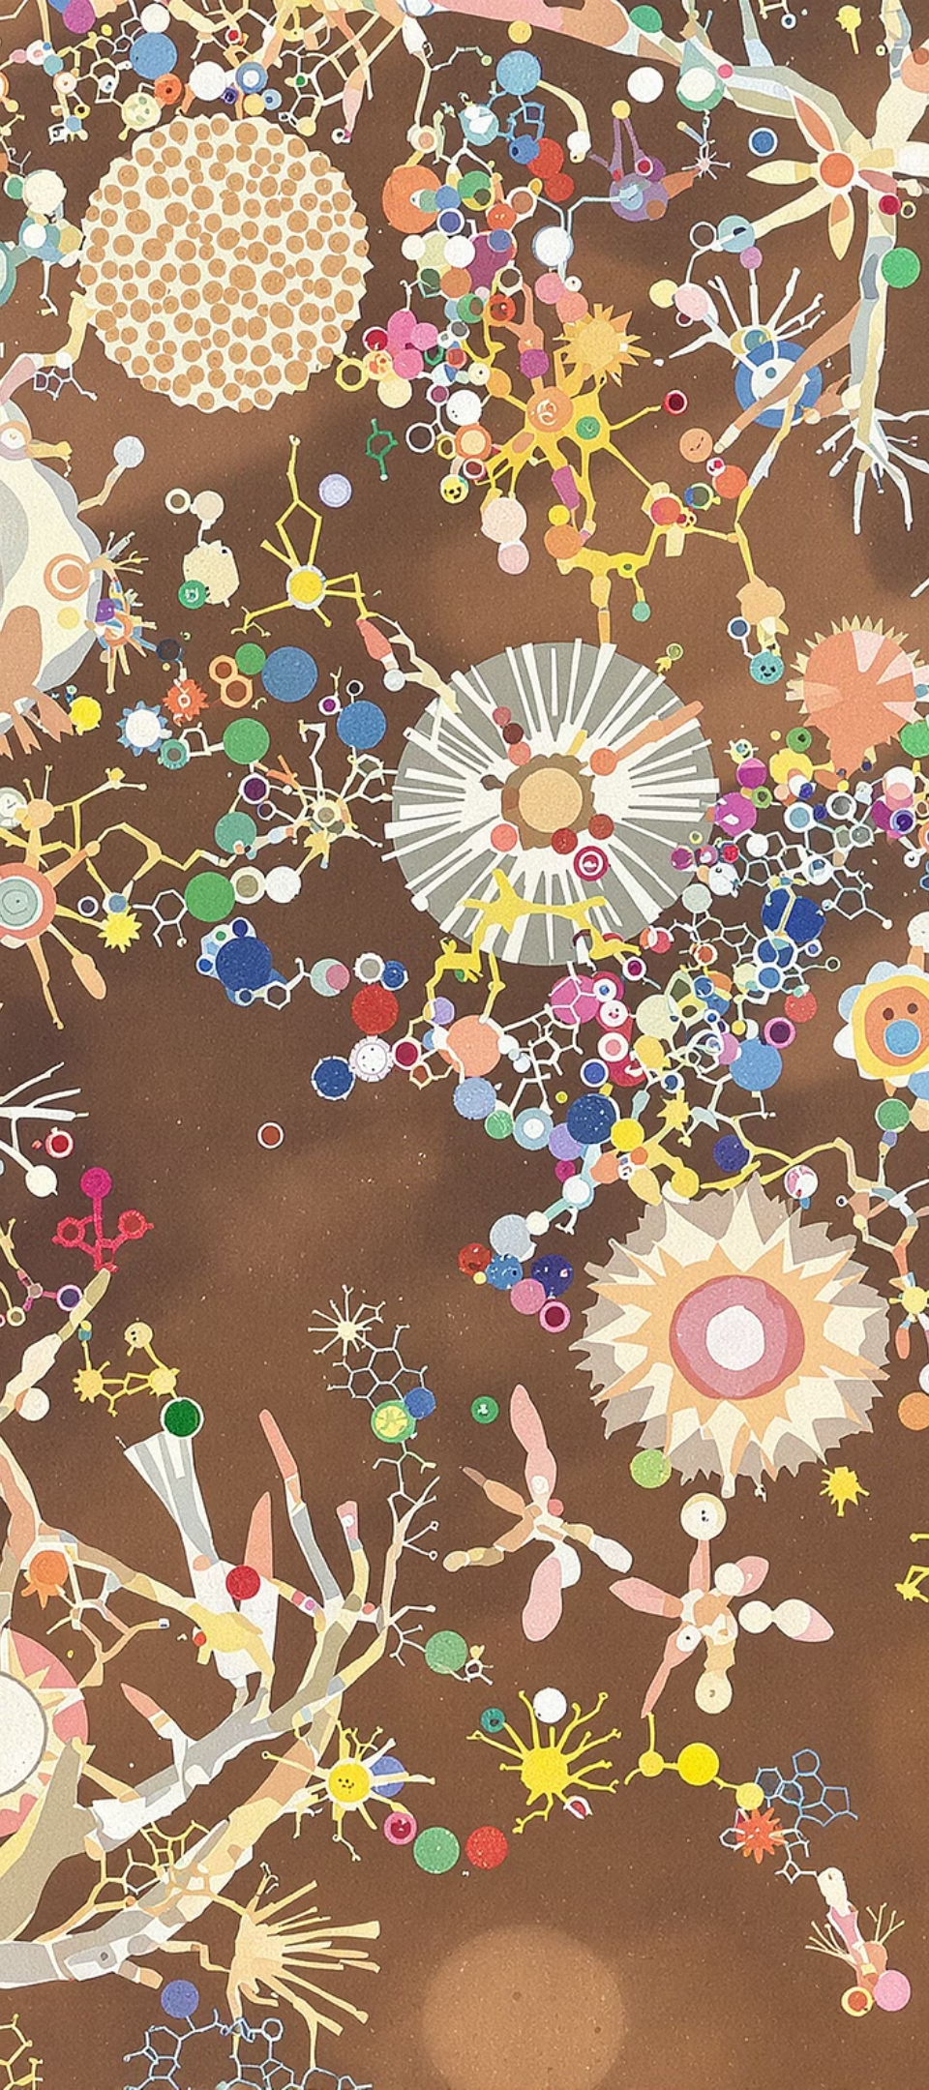



Why It Matters
Metabolic Problems
Common Correlation
Treatment Approach
Many mental health issues often come with insulin resistance and chronic inflammation
Seen in mental illness such as depression, bipolar, ADHD, schizophrenia and neurodegenerative disorders like dementia
Addressing metabolic issues may reduce mental health symptoms by improving the energy system of the body and brain.
Notes:
Many mental health conditions—like depression, bipolar disorder, ADHD, and dementia—are linked to problems with metabolism, such as insulin resistance and inflammation. These problems can make it harder for the body and brain to get the energy they need, which affects mood, focus, and thinking. By taking care of these metabolic issues, we can help the brain work better and support overall mental health, which may reduce symptoms.

Slide 7

Metabolism + Brain – Quick Stats
Depression Risk
Metabolic Issues
Insulin Resistance
2-3x
> 40%
4 in 10
Higher risk in people with type 2 diabetes
Of people with serious mental illness have metabolic dysfunction
Young adults have it—even if not diabetic or obese
Notes:
Looking at some of these statistics we can see that mental health and metabolic health are strongly connected. It is important to note that many people have poor metabolic health even if they don’t show outward signs and symptoms.
*Insulin resistance meaning the body’s cells become less responsive to insulin - the hormone that helps move glucose from the bloodstream into cells for energy
CDC – “People with diabetes are 2 to 3 times more likely to have depression than people without diabetes.”
Stanford Report – “Mental and metabolic illnesses frequently occur together: More than 40% of people with severe mental illnesses also have metabolic syndrome.”
Parcha et. al. 2022- “Conclusions: Four-in-10 young American adults have IR, which occurs in a cluster with cardiometabolic risk factors. Nearly half of young adults with IR are nonobese.”

Slide 8

The Science – Simplified
Brain Power
1
The brain uses roughly
20% of our energy
2
Energy Dysregulation
Poor energy = brain fog, mood swings. This could look like depression and/or mania.
Energy Support
3
Better metabolism = improved focus, mood stability
Notes:
As the brain uses about 20% of our total energy, which is a lot considering it makes up only 2% of total body weight. This shows how energy-intensive the brain really is—every thought, emotion, and action depends on a constant, efficient energy supply.
It makes sense that if energy metabolism is dysregulated or malfunctioning, brain function can be affected. We can see this in mental health conditions: for example, low energy or inefficient brain metabolism may contribute to depression, while hyperactive or dysregulated energy use could be involved in mania.

Slide 9
Fueling the Brain: Glucose and Ketones
The brain primarily uses two energy sources: glucose and ketones.
1
Glucose
2
Ketones
Derived from carbohydrates, it is the body’s default and readily available fuel.
Produced from fat when carbohydrate intake is low (during fasting or a ketogenic diet).
Notes:
Under most conditions, the brain relies mainly on glucose, which can come from carbohydrates in the diet. When glucose is limited—such as during fasting, low-carb diets, or ketogenic diets—our bodies will produce ketones from fat stores.
Ketones can cross the blood-brain barrier and provide a stable, efficient energy source for the brain.
Why this matters for mental health:
Ketones can support brain energy stability, improve mitochondrial function, and reduce oxidative stress.
For some people, especially those with metabolic dysfunction or mood disorders, ketones may help stabilize mood and cognitive function.
Understanding both glucose and ketones highlights how brain energy availability affects mental function and why metabolic approaches can influence psychiatric outcomes.

Slide 10
Glucose vs. Ketones for Energy
Glucose
Ketones
Most Standard American Diet (SAD Diets) are high in sugars and carbs, which break down into glucose for energy.
Fuel from fat; provides steady energy for the brain
Some brains use ketones better, especially when glucose processing is impaired
Sugar from carbs; quick fuel, but unstable energy source
Increased ketone production can be achieved through a Ketogenic Diet intervention
Can lead to energy crashes and mood swings
Increased levels of glucose can cause insulin resistance over time
Notes:
Review these key points and consider asking audience the following:
Have you ever noticed a drop in energy or feeling sleepy after a large meal?
Do you feel more mentally alert when you skip a meal or go a few hours without eating?
Can you recall a time when a change in your diet seemed to impact your mood or mental clarity?

Slide 11

What is Ketogenic Therapy?
Notes:
In this short video Dr. Bret Scher discusses ketogenic therapy and the underlying mechanisms that make it so powerful.
*play video

Slide 12
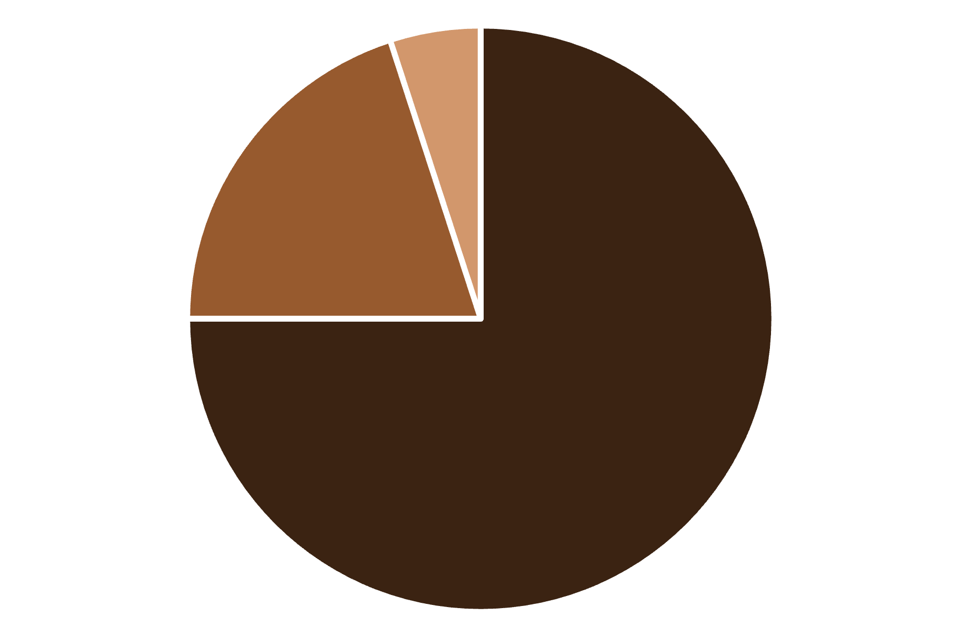
What is the Keto Diet?
1
High Fat
70-75% of calories
2
Moderate Protein
20-25% of calories
3
Very Low Carb
5-10% of calories
4
Ketone Production
Trains body to burn fat, not sugar
FAT
PROTEIN
CARBS
Notes:
A ketogenic diet is a very low-carbohydrate, high-fat diet that shifts the body’s metabolism from using glucose to using fat as the primary fuel source. When carbohydrate intake is drastically reduced, the liver converts fat into molecules called ketones, which can be used by the brain and body for energy. This state is called ketosis, where the body relies primarily on ketones instead of glucose for its energy source.
As we can see here, a typical macro breakdown for ketogenic therapies often has the following macro breakdown: Fats: ~70–75% of daily calories Protein: ~20–25%, Carbohydrates: ~5–10% (3:1 ratio). It’s important to note that the macros can vary slightly from person-to-person ie: a person with Epilepsy may require a 4:1 ratio.

Slide 13




Mitochondrial Health
Metabolic psychiatry focuses on optimizing mitochondrial function for better mental health.
Power Plants
Mitochondria are the cellular energy factories essential for brain function
Brain Energy
These organelles produce ATP, the primary fuel our brains need to regulate mood and cognition
When Damaged
Mitochondrial dysfunction leads to energy dysregulation, contributing to depression, mania, psychosis, anxiety, and cognitive impairment
Notes:
We can’t talk about metabolism without introducing mitochondria - often referred to as the powerhouse of the cells.
Mitochondria are tiny organelles inside cells that convert nutrients into energy in the form of ATP, which powers everything our cells do.
Healthy mitochondria are essential for energy production, brain function, and overall cellular health. If mitochondria aren’t functioning well, cells can’t produce enough energy, which may contribute to fatigue, cognitive issues, mood dysregulation, and other mental health symptoms.
Mitochondrial dysfunction has been linked to depression, bipolar disorder, and other psychiatric conditions, emphasizing the link between metabolism and mental health.

Slide 14



Why Metabolic Psychiatry Matters
Connected Systems
Mental health is deeply linked to metabolic health
Energy Foundation
Mood and cognition rely on how we fuel the brain
New Healing Tools
Opens up options when other approaches don't work
Notes:
Metabolic psychiatry matters because it connects the dots between metabolism, brain function, and mental health.
Traditional psychiatry often focuses on neurotransmitters and symptoms, but many psychiatric conditions—like depression, bipolar disorder, ADHD, and cognitive decline—have underlying metabolic components. How we fuel our brain matters.
By addressing energy metabolism, mitochondrial function, and inflammation, metabolic psychiatry targets root causes rather than just symptoms.

Slide 15

Practical Applications: Foundational Pillars
Implementing metabolic psychiatry involves a holistic approach, focusing on key lifestyle areas that profoundly impact mental well-being.
Let's explore some core metabolic interventions:
Notes:
Applying metabolic psychiatry in practice involves a holistic, lifestyle-based approach that targets key factors influencing metabolic and mental health. Rather than a single intervention, it focuses on foundational pillars that support the body and brain’s energy systems

Slide 16




Nutrition
Ketogenic & Low-Carb
Reduce Sugar
Healthy Fats
Ketogenic or Carnivore diets when appropriate for the individual
Minimize sugar and ultra-processed foods that disrupt metabolism
Include omega-3s and other brain-supporting fats
Notes:
Nutrition is a core pillar of metabolic psychiatry. For some individuals, ketogenic, low-carbohydrate, or carnivore-style approaches may be appropriate when tailored to personal needs and medical guidance. Reducing sugar and ultra-processed foods can help stabilize metabolism and inflammation. Emphasizing healthy fats, including omega-3s, supports brain function and energy metabolism.

Slide 17

Movement
Strength Training
Walking
Mind-Body Practices
Builds muscle and improves insulin sensitivity
Gentle, accessible movement that regulates blood sugar
Yoga and tai chi support stress reduction, improving mitochondrial function
Notes:
Strength Training: Strength training builds skeletal muscle, which is one of the main tissues that take up glucose from the bloodstream. More muscle means the body can use insulin more efficiently, improving insulin sensitivity and overall metabolic function.
Walking: Walking is a low-impact, accessible form of movement that helps regulate blood sugar throughout the day. Regular walking improves circulation, enhances glucose uptake by muscles, and supports cardiovascular health.
Mind-Body Practices (Yoga, Tai Chi):Stress can negatively affect metabolism by increasing cortisol, which can worsen insulin resistance and promote inflammation. Mind-body practices like yoga and tai chi reduce stress, lower inflammation, and improve hormonal balance. By creating these conditions, they indirectly support mitochondrial function

Slide 18




Sleep
Morning Light
Consistent Schedule
Evening Routine
Quality Rest
Get sunlight exposure early in the day
Maintain regular sleep-wake times
Limit screens, use blue light blockers
Support brain repair and regulation
Notes:
Morning light helps set your circadian rhythm, supporting energy balance and insulin sensitivity. Keeping a consistent sleep schedule and limiting evening screen time promotes hormonal balance and restorative sleep. Quality sleep allows the brain and body to repair, regulate energy, and maintain healthy metabolism.

Slide 19


How to Get Started:
The THINK + SMART Framework
Find THINK + SMART on www.metabolicmind.org
Notes:
Nutrition is often the best starting point because what we eat directly affects blood sugar, brain energy, and inflammation. As you’ve learned throughout this presentation, high-fat, low-carb diets—like ketogenic approaches—can offer several benefits for metabolic and mental health.
Poor sleep and chronic stress worsen inflammation and metabolic dysfunction.
Regular exercise supports insulin sensitivity, mitochondrial function, and mood.
In this video, Hannah Warren introduces the THINK+SMART framework—a self-guided tool developed by Metabolic Mind - designed to support individuals interested in incorporating metabolic interventions into their mental health care.
*play video

Slide 20
Key Takeaways
1
Whole-Body Approach
Mental health is connected to how our body produces and uses energy
2
Lifestyle Foundation
Nutrition, movement, and sleep are powerful tools for brain health
3
Personalized Care
Work with healthcare providers to find your optimal approach
4
Emerging Field
Metabolic psychiatry offers new hope for mental health treatment
Notes:
When we bring all of this together, the main takeaway is that metabolic psychiatry is truly a whole-body approach to mental health. The brain doesn’t function in isolation—mental health is deeply connected to how the body creates, stores, and uses energy.
Supporting mental health, from a metabolic perspective, focuses on foundational lifestyle factors: nutrition, sleep, and movement. These directly influence brain energy, inflammation, insulin sensitivity, and overall metabolic health.
It’s also important to emphasize that there is no one-size-fits-all approach. Metabolic interventions should be personalized, and individuals should always work with a qualified clinician before making significant lifestyle changes, especially when managing mental health conditions.
Finally, while metabolic psychiatry is still an emerging field, the growing body of research offers real hope. For some individuals, addressing metabolic health may be a powerful and effective component of mental health treatment.

Slide 21



Safety Considerations
Professional Guidance
Medication Interactions
Individual Factors
Always consult healthcare providers before major changes
Special care and medication monitoring may be required when implementing a ketogenic diet
Consider eating disorder history, pregnancy, or breastfeeding
Notes:
*This slide is self-explanatory and can be read directly to the audience.

Slide 22
Where to Learn More
These resources provide practical guidance on metabolic lifestyle changes:
• Metabolic Mind - A comprehensive educational platform offering courses, articles, and tools for implementing metabolic approaches such as THINK + SMART. www.metabolicmind.org
• Dr. Georgia Ede's Clinician Directory - Find healthcare professionals trained in metabolic psychiatry and nutritional approaches to mental health. www.diagnosisdiet.com
• Brain Energy - is a groundbreaking book by Harvard psychiatrist Dr. Christopher Palmer, introducing the revolutionary idea: that metabolic dysfunction is the common root cause of all mental illness. brainenergy.com
Notes:
*These are three recommended resources for the audience to explore. Feel free to modify them based on your target audience.

Slide 23


Thank You
Metabolic Collective is a nonprofit organization that provides educational resources to independent advocates like me who are volunteering to spread awareness of metabolic therapies for psychiatric and neurological conditions.
Website: MetabolicCollective.org
Visit our website for more information and resources
Social Media
Follow us on Facebook and X to be a part of our community discussions
Notes:
*This is a thank-you slide. Thank the audience for their time and attention.
* Option – you may want to consider adding social media links if used.

Slide 24
References
Anderson RJ et al. (2001)
The prevalence of comorbid depression in adults with diabetes: a meta-analysis. Diabetes Care. PMID: 11375373
CDC National Diabetes Statistics Report (2023)
More than 50% of adults have prediabetes or diabetes. CDC.gov
CDC (2024)
Centers for Disease Control and Prevention. (2024, May 15). Diabetes and mental health. U.S. Department of Health and Human Services. Retrieved August 25, 2025, from https://www.cdc.gov/diabetes/living-with/mental-health.html
Parcha, V., Heindl, B., Kalra, R., Li, P., Gower, B., Arora, G., & Arora, P. (2022)
Insulin resistance and cardiometabolic risk profile among nondiabetic American young adults: insights from NHANES. The Journal of Clinical Endocrinology & Metabolism, 107(1), e25-e37.
Vancampfort D et al. (2015)
Metabolic syndrome and metabolic abnormalities in bipolar disorder: a meta-analysis of prevalence rates and moderators. Am J Psychiatry. PMID: 25990361
Stanford Medicine (2025)
Stanford Medicine expert shares five key insights on keto therapy and mental illness. Stanford News. https://news.stanford.edu/stories/2025/04/keto-diet-therapy-mental-illness-research
Notes:
*References for the stats slide #7

